Slide 1

Allianz
OCEAN VOYAGE AD&D INSURANCE
Presented by
Monika Saradha

Slide 2
Issue:
In 1921, ocean liners were the only commercial passenger option and many individuals relied on these voyages for migration, business, and leisure.
The sinking of the Titanic - faced significant financial setbacks due to the many claims.
Problem: If we continue to underwrite policies- there's a potential for significant financial losses.
Solution - We need a robust underwriting model that considers the risk factors evident from the Titanic disaster to make informed decisions on whom to insure, ensuring profitability and sustainability.

Slide 3
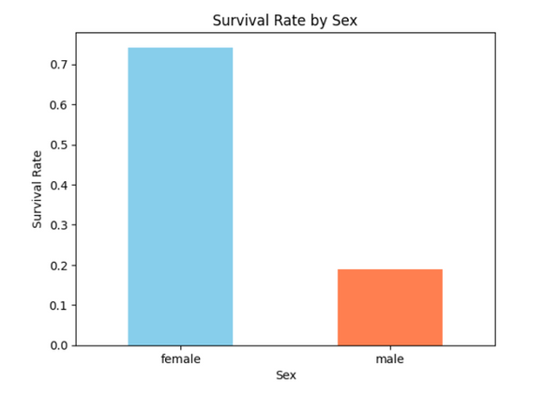
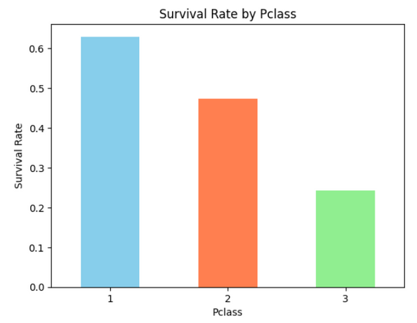
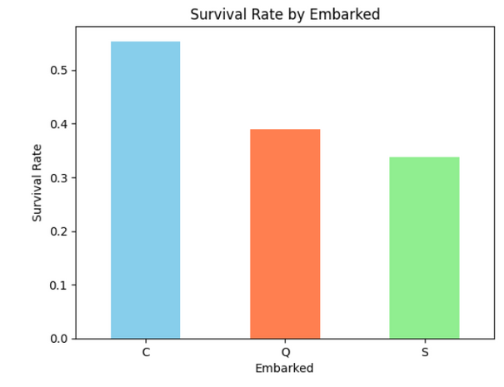
Analysis
Sex: Female passengers had a higher survival rate compared to male passengers.
Class: 1st class passengers had a higher survival rate compared to 2nd and 3rd class passengers.
Age: Younger passengers, especially children, had a higher survival rate.

Slide 4
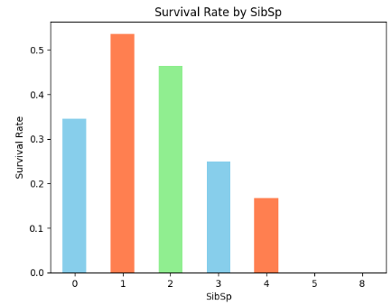
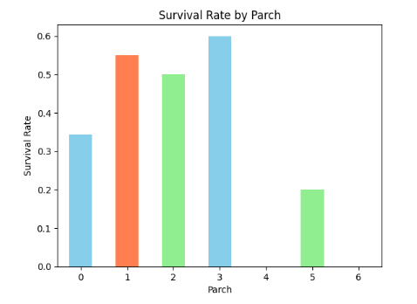
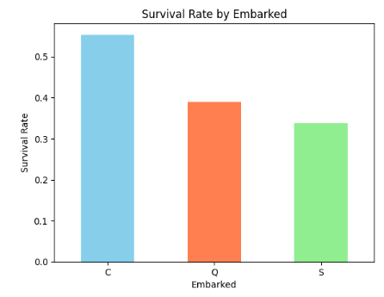
Siblings/Spouses: Passengers with 1 or 2 siblings/spouses had a higher survival rate than those with none or more than 2.
Parents/Children: Passengers with 1 parent/child had a higher survival rate.
Embarked: Passengers who boarded from Cherbourg had a slightly higher survival rate.

Slide 5
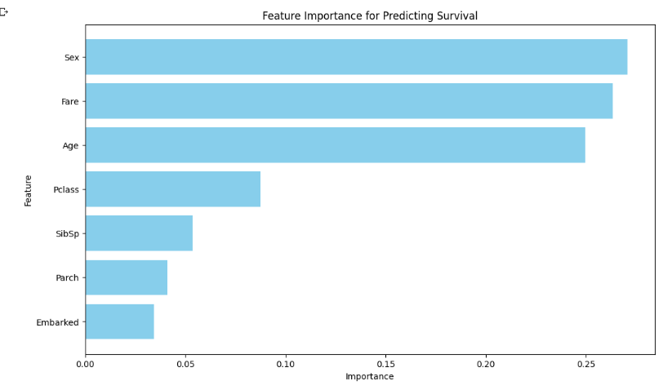
Recommendations:
Based on the Titanic data, our main predictors for assessing the risk of accidental death and dismemberments are:

Slide 6
Gender-based Premiums:
Consider charging higher premiums for male passengers or offering discounts for female passengers due to the higher survival rate observed in females.
Class-based Premiums:
Higher premiums for 3rd class passengers and lower for 1st class passengers. Consider a moderate rate for 2nd class passengers.
Age-based Premiums:
Introduce tiered premiums based on age groups, with children and young adults receiving lower rates.
Family Size:
Moderate premiums for those with 1-2 family members onboard. Higher rates for larger families due to potential risk concentration.
Boarding Point:
Consider a slightly higher premium for those embarking from Southampton and Queenstown compared to Cherbourg.

Slide 7
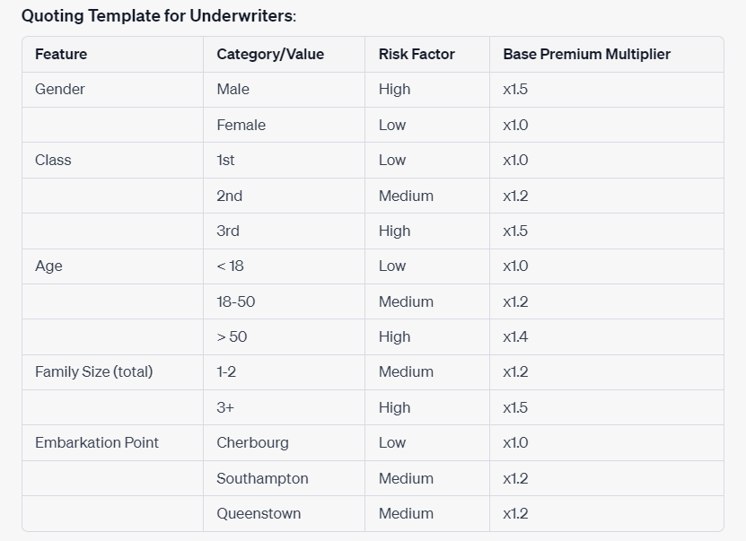
Thank
you!

Slide 8
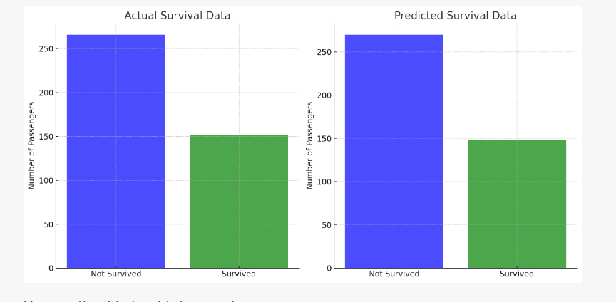
Feature Engineering & Random Forest Modelling
0.77511

